Slide 1
C Programming

Slide 2
C Programming
C is a general-purpose programming language that is extremely popular, simple and flexible. It is machine-independent, structured programming language which is used extensively in various applications.

Slide 3
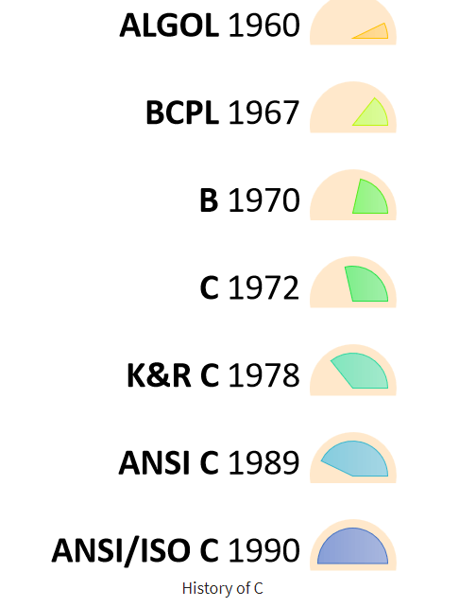
History of ‘C’
'C' was developed by Dennis Ritchie in 1972.

Slide 4
Why C ?
C' is a base language for many programming languages.
It is a simple language and provides faster execution.
'C' is a structured programming language in which program is divided into various modules.
'C' programming is that it can extend itself. A 'C' program contains various functions which are part of a library.
It is a highly portable language which means programs written in 'C' language can run on other machines.

Slide 5
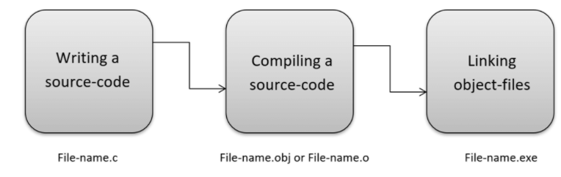
How it Works

Slide 6
Software
DevC++
Code::Blocks

Slide 7
A C program basically consists of the following parts −
Preprocessor Commands
Functions
Variables
Statements & Expressions
Comments

Slide 8
First program
#include <stdio.h>
int main() {
/* my first program in C */
printf("Hello, World! \n");
return 0;
}

Slide 9
Tokens in C
A C program consists of various tokens and a token is either a keyword, an identifier, a constant, a string literal, or a symbol. For example, the following C statement consists of five tokens −
printf("Hello, World! \n");
The individual tokens are −
printf
(
"Hello, World! \n“
)
;

Slide 10
Semicolons
In a C program, the semicolon is a statement terminator.
printf("Hello, World! \n");
return 0;

Slide 11
Comments
Two types of comments
Single line comment
// my first program in C
Multiline comment
/* my first
program in C */

Slide 12
Identifiers
A C identifier is a name used to identify a variable, function, or any other user-defined item.
C is a case-sensitive programming language.
Examples:
mohd zara abc move_name a_123 myname50 _temp j a23b9 retVal

Slide 13
Keywords
auto | else | long | switch
Break | enum | register | typedef
case | extern | return | union
char | float | short | unsigned
const | for | signed | void
continue | goto | sizeof | volatile
default | if | static | while
do | int | struct | _Packed
double

Slide 14
Data types in C
Basic Arithmetic types - further classified into: (a) integer types and (b) floating-point types
Enumerated types - arithmetic types that are used to define variables that can be assigned only certain discrete integer values throughout the program
Type void - indicates that no value is available
Derived types - They include (a) Pointer types, (b) Array types, (c) Structure types, (d) Union types and (e) Function types

Slide 15
Broad Classification of Data Types
Numerical data types are broadly classified into
Signed
Unsigned
Signed can store zero, positive and negative values
Unsigned can store only zero and positive values
Char and bool are unsigned data types
Some applications use unsigned data types only Eg: age

Slide 16
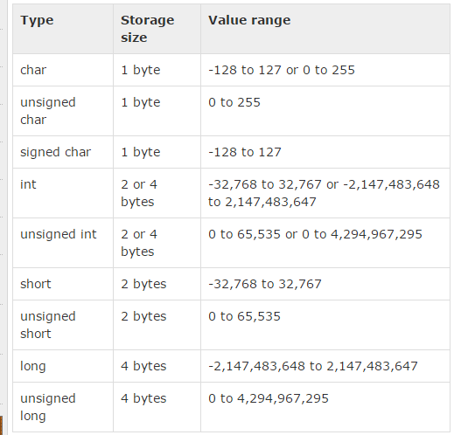
Integer Types

Slide 17
Floating-Point Types
Type | Storage size | Value range | Precision
float | 4 byte | 1.2E-38 to 3.4E+38 | 6 decimal places
double | 8 byte | 2.3E-308 to 1.7E+308 | 15 decimal places
long double | 10 byte | 3.4E-4932 to 1.1E+4932 | 19 decimal places

Slide 18
The void Type
Function returns as void
void exit (int status);
Function arguments as void
int rand(void);
Pointers to void
void *malloc( size_t size );

Slide 19
Variables
A variable is nothing but a name given to a storage area that our programs can manipulate.
Type | Description
char | Typically a single octet(one byte). This is an integer type.
int | The most natural size of integer for the machine.
float | A single-precision floating point value.
double | A double-precision floating point value.
void | Represents the absence of type.

Slide 20
Variable Definition in C
A variable definition tells the compiler where and how much storage to create for the variable.
Syntax
type variable_list;
Examples
int i, j, k;
char c, ch;
float f, salary;
double d;

Slide 21
C - Constants & Literals
#include <stdio.h>
#define LENGTH 10
#define WIDTH 5
#define NEWLINE '\n'
int main() {
int area;
area = LENGTH * WIDTH;
printf("value of area : %d", area);
printf("%c", NEWLINE);
return 0;
}
#include <stdio.h>
int main() {
const int LENGTH = 10;
const int WIDTH = 5;
const char NEWLINE = '\n';
int area;
area = LENGTH * WIDTH;
printf("value of area : %d", area);
printf("%c", NEWLINE);
return 0;
}

Slide 22
Arithmetic Operators
Operator | Description | Example
+ | Adds two operands. | A + B = 30
− | Subtracts second operand from the first. | A − B = -10
* | Multiplies both operands. | A * B = 200
/ | Divides numerator by de-numerator. | B / A = 2
% | Modulus Operator and remainder of after an integer division. | B % A = 0
++ | Increment operator increases the integer value by one. | A++ = 11
-- | Decrement operator decreases the integer value by one. | A-- = 9

Slide 23
Logical Operators
Operator | Description | Example
&& | Called Logical AND operator. If both the operands are non-zero, then the condition becomes true. | (A && B) is false.
|| | Called Logical OR Operator. If any of the two operands is non-zero, then the condition becomes true. | (A || B) is true.
! | Called Logical NOT Operator. It is used to reverse the logical state of its operand. If a condition is true, then Logical NOT operator will make it false. | !(A && B) is true.

Slide 24
Bitwise Operators
Operator | Description | Example
& | Binary AND Operator copies a bit to the result if it exists in both operands. | (A & B) = 12, i.e., 0000 1100
| | Binary OR Operator copies a bit if it exists in either operand. | (A | B) = 61, i.e., 0011 1101
^ | Binary XOR Operator copies the bit if it is set in one operand but not both. | (A ^ B) = 49, i.e., 0011 0001
~ | Binary Ones Complement Operator is unary and has the effect of 'flipping' bits. | (~A ) = -61, i.e,. 1100 0011 in 2's complement form.
<< | Binary Left Shift Operator. The left operands value is moved left by the number of bits specified by the right operand. | A << 2 = 240 i.e., 1111 0000
>> | Binary Right Shift Operator. The left operands value is moved right by the number of bits specified by the right operand. | A >> 2 = 15 i.e., 0000 1111

Slide 25
Assignment Operators
Operator | Description | Example
= | Simple assignment operator. Assigns values from right side operands to left side operand | C = A + B will assign the value of A + B to C
+= | Add AND assignment operator. It adds the right operand to the left operand and assign the result to the left operand. | C += A is equivalent to C = C + A
-= | Subtract AND assignment operator. It subtracts the right operand from the left operand and assigns the result to the left operand. | C -= A is equivalent to C = C - A
*= | Multiply AND assignment operator. It multiplies the right operand with the left operand and assigns the result to the left operand. | C *= A is equivalent to C = C * A
/= | Divide AND assignment operator. It divides the left operand with the right operand and assigns the result to the left operand. | C /= A is equivalent to C = C / A

Slide 26
%= | Modulus AND assignment operator. It takes modulus using two operands and assigns the result to the left operand. | C %= A is equivalent to C = C % A
<<= | Left shift AND assignment operator. | C <<= 2 is same as C = C << 2
>>= | Right shift AND assignment operator. | C >>= 2 is same as C = C >> 2
&= | Bitwise AND assignment operator. | C &= 2 is same as C = C & 2
^= | Bitwise exclusive OR and assignment operator. | C ^= 2 is same as C = C ^ 2
|= | Bitwise inclusive OR and assignment operator. | C |= 2 is same as C = C | 2

Slide 27
Misc Operators
Operator | Description | Example
sizeof() | Returns the size of a variable. | sizeof(a), where a is integer, will return 4.
& | Returns the address of a variable. | &a; returns the actual address of the variable.
* | Pointer to a variable. | *a;
? : | Conditional Expression. | If Condition is true ? then value X : otherwise value Y

Slide 28
Relational Operators
Operator | Description | Example
== | Checks if the values of two operands are equal or not. If yes, then the condition becomes true. | (A == B) is not true.
!= | Checks if the values of two operands are equal or not. If the values are not equal, then the condition becomes true. | (A != B) is true.
> | Checks if the value of left operand is greater than the value of right operand. If yes, then the condition becomes true. | (A > B) is not true.
< | Checks if the value of left operand is less than the value of right operand. If yes, then the condition becomes true. | (A < B) is true.
>= | Checks if the value of left operand is greater than or equal to the value of right operand. If yes, then the condition becomes true. | (A >= B) is not true.
<= | Checks if the value of left operand is less than or equal to the value of right operand. If yes, then the condition becomes true. | (A <= B) is true.

Slide 29
The scanf() and printf() Functions
#include<stdio.h> void main() { int a ; int b ;
scanf(“%d%d”,&a,&b); printf("%d%d",a,b); }

Slide 30
printf and scanf format codes
code | type | format
d | int | decimal (base ten) number
o | int | octal number (no leading '0' supplied in printf)
x or X | int | hexadecimal number (no leading '0x' supplied in printf; accepted if present in scanf) (for printf, 'X' makes it use upper case for the digits ABCDEF)
ld | long | decimal number ('l' can also be applied to any of the above to change the type from 'int' to 'long')

Slide 31
printf and scanf format codes
code | type | format
u | Unsigned int | decimal number
lu | unsigned long | decimal number
c | char [footnote] | single character
s | char pointer | string
f | float [footnote] | number with six digits of precision
lf | double [footnote] | number with six digits of precision

